Slide 1
Python Machine Learning In Biology:
Machine Learning Overview
Nichole Bennett

Slide 2
Course Information

Slide 3


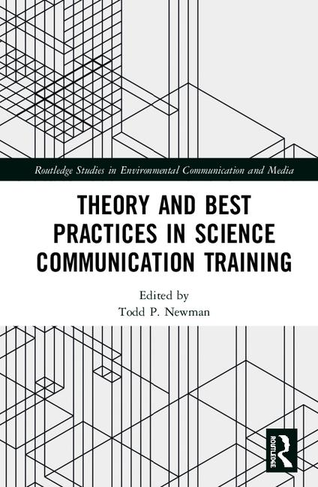
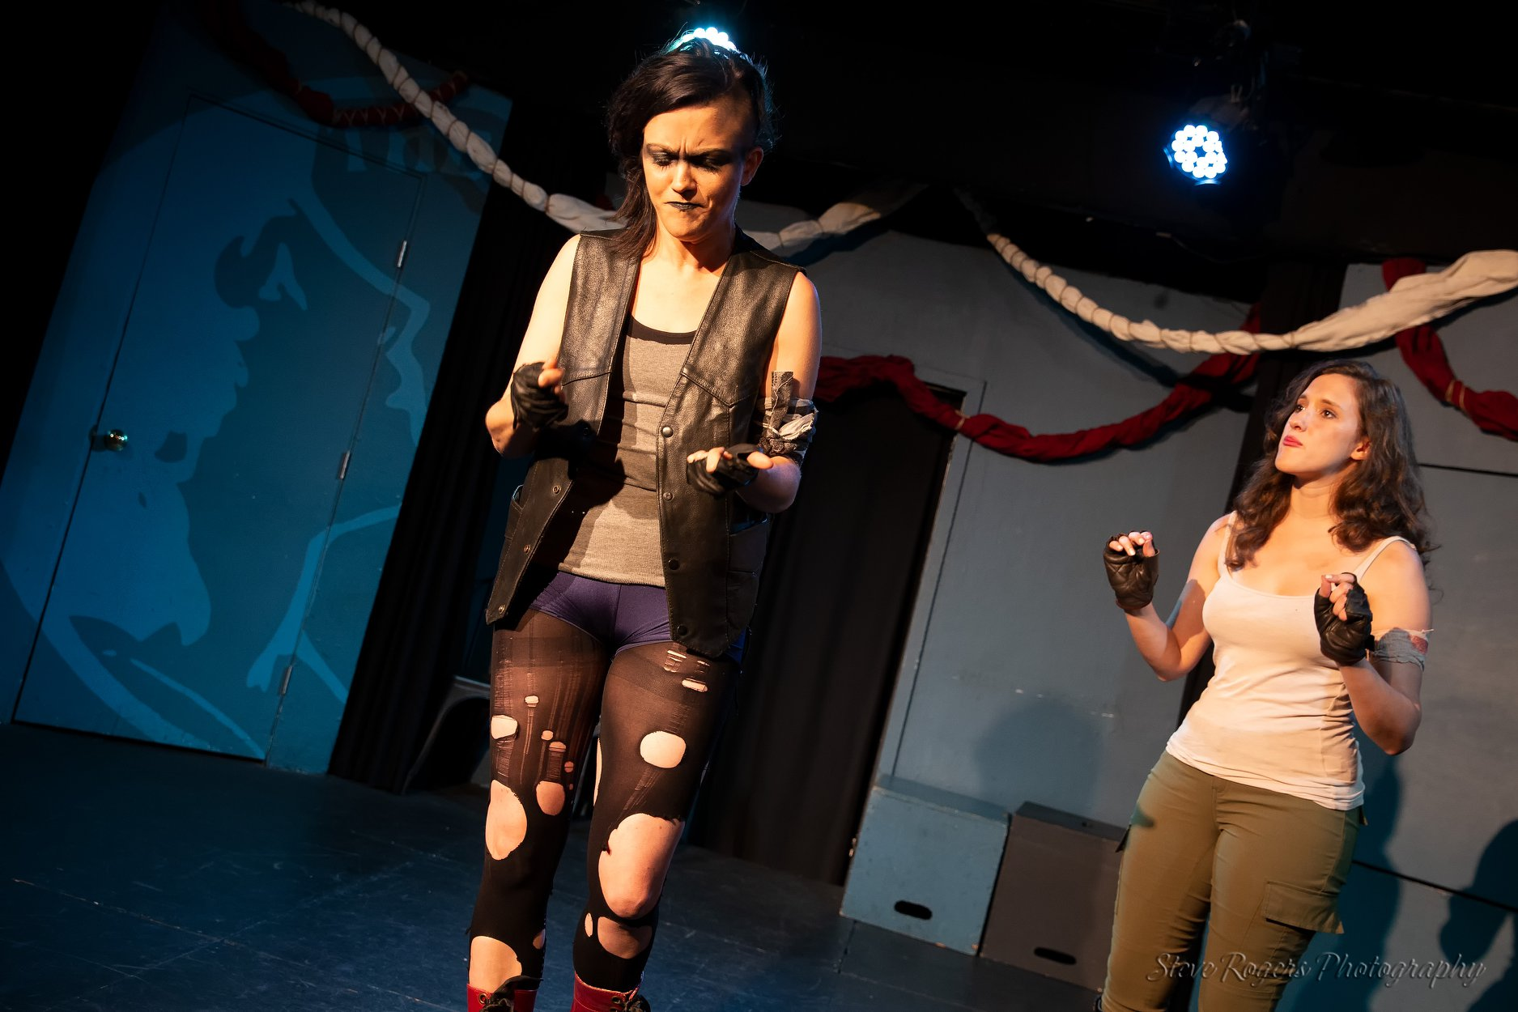


About Me
Used to research climate change impacts on butterflies (ecology, evolution, behavior, some genomics)
Then, I taught adults data science with General Assembly and taught kids coding through various programs.
Now I research science communication.
In my spare time, I do lots of theater.

Slide 4
About You
Find a partner, find out the following about them:
Name
Where they are from (hometown and current university)
What they research
Why they are here
One fun fact
Then, we’ll share.

Slide 5
Course Overview (subject to change)
Day 1: Intro to Machine Learning, Python Foundations, Pandas
Day 2: Data Viz, Logistic Regression, KNN, Bias-Variance Tradeoff
Day 3: Morning Break, Data Preprocessing, SVM
Day 4: Hyperparameter Tuning, Evaluation Metrics, Decision Trees, Ensemble Learners, Dimensionality Reduction, Feature Selection
Day 5: Clustering, Neural Networks
Anything missing on here that you were hoping for?

Slide 6
Course expectations
Wide and Shallow.
You’ll get an overview of the tools available and be able to pick the right ones for the job at hand. (You won’t be expert on any of them).
My goals are that you’ll be able to match a task to a problem, know the pros and cons of several algorithms, be able to run them in Python, and be able to evaluate and interpret their output.
You’ll also get a lot of “best practices” advice. We’ll talk about how to preprocess your data, how to tune your models, and how to evaluate them.

Slide 7
How this course will go
Some theory/lecture
We’ll focus on getting an intuition for how the algorithms work and being able to apply machine learning.
Code-alongs
You can do these as you please (watch, code-along, execute-along)
Independent work (means independent from top-down instruction)
The datasets we are using and why.
My thoughts on passive learning. Rant, rant, rant.

Slide 8

Prerequisites
This should be pretty beginner-friendly.
Feel free to speak out if you don’t understand something--I’ll adjust.
I’ll assume a little knowledge of statistics and Python, but we can review those as needed.
Notes:
Domains of Machine Learning (Stats, Programming, Domain Knowledge)
Good to know where you stand here so you can know what you’d like to do to continue growing
Although many ML algorithms use linear algebra, we’ll get an intuition for what they’re doing without needing to learn it
Will provide resources for you

Slide 9

Install Help Time!
We won’t use these until later, so if you don’t have them, let’s get those downloads started.
Mac/Linux Users: Go to your Terminal and type conda list
PC Users: Go to your Anaconda Prompt and type conda list
(optional) PC Users: Download Git Bash https://git-for-windows.github.io/

Slide 10
Questions About Course In General?
Any Requests?

Slide 11
Introduction to Machine Learning

Slide 12
What is machine learning?
Think-Pair-Share

Slide 13
What is machine learning?
The semi-automated extraction of knowledge from data.

Slide 14
What is machine learning?
The semi-automated extraction of knowledge from data.
Knowledge from data: Starts with a question that might be answerable using data
Automated extraction: A computer provides the insight
Semi-automated: Requires many smart decisions by a human

Slide 15
What is Machine Learning?
Machine Learning is the science of getting computers to learn and act like humans do and improve their learning over time in autonomous fashion, by feeding them data and information in the form of observations and real-world interactions.
Instead of humans having to manually derive rules and build models for large data sets, the computer gradually improves the performance of predictive models.
This is great for some problems, but it’s not a cure-all.

Slide 16
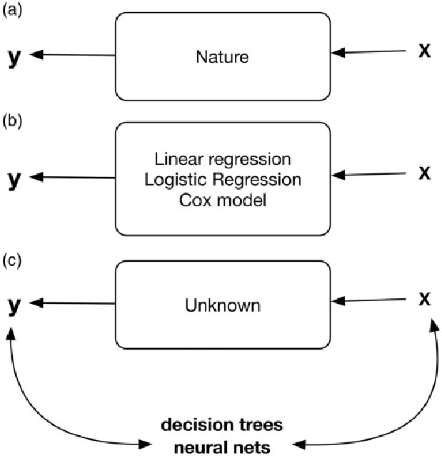
The “Two Cultures” of Statistical Modeling
a) who knows? Nature doing Nature things.
b) assume a stochastic data model, want explanations
c) assume complex and unknown, want accurate predictions

Slide 17
The “Two Cultures” of Statistical Modeling
Two goals for analyzing data:
Extract some information about
how nature is associating the response variables to the input variables. (a)
Predict what the responses are going to be to future input variables. (b)

Slide 18
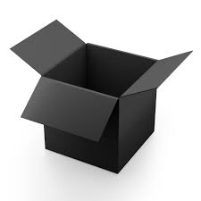
Machine Learning is useful for accurate predictions for unknown data
...not as much for explaining relationships between variables.

Slide 19
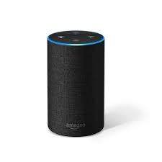

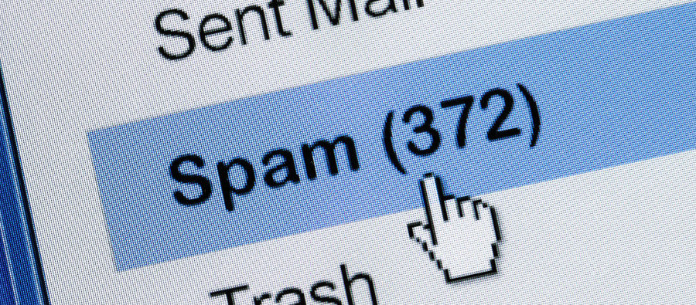
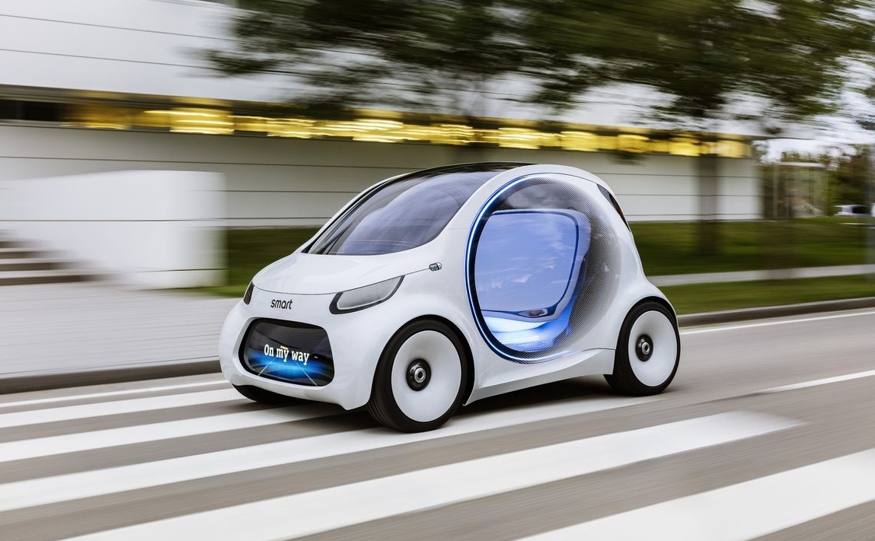
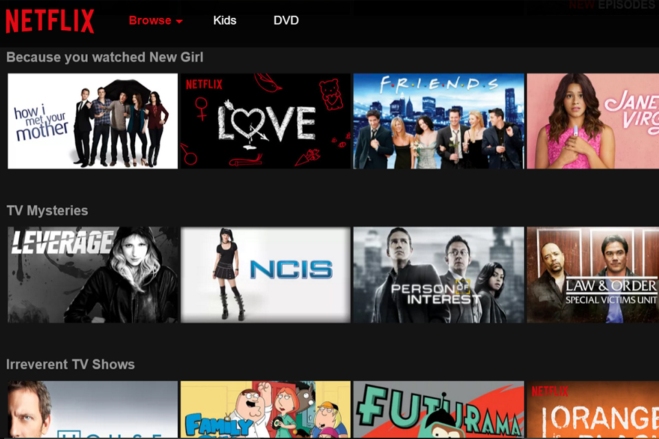

Applications of Machine Learning

Slide 20


Slide 21
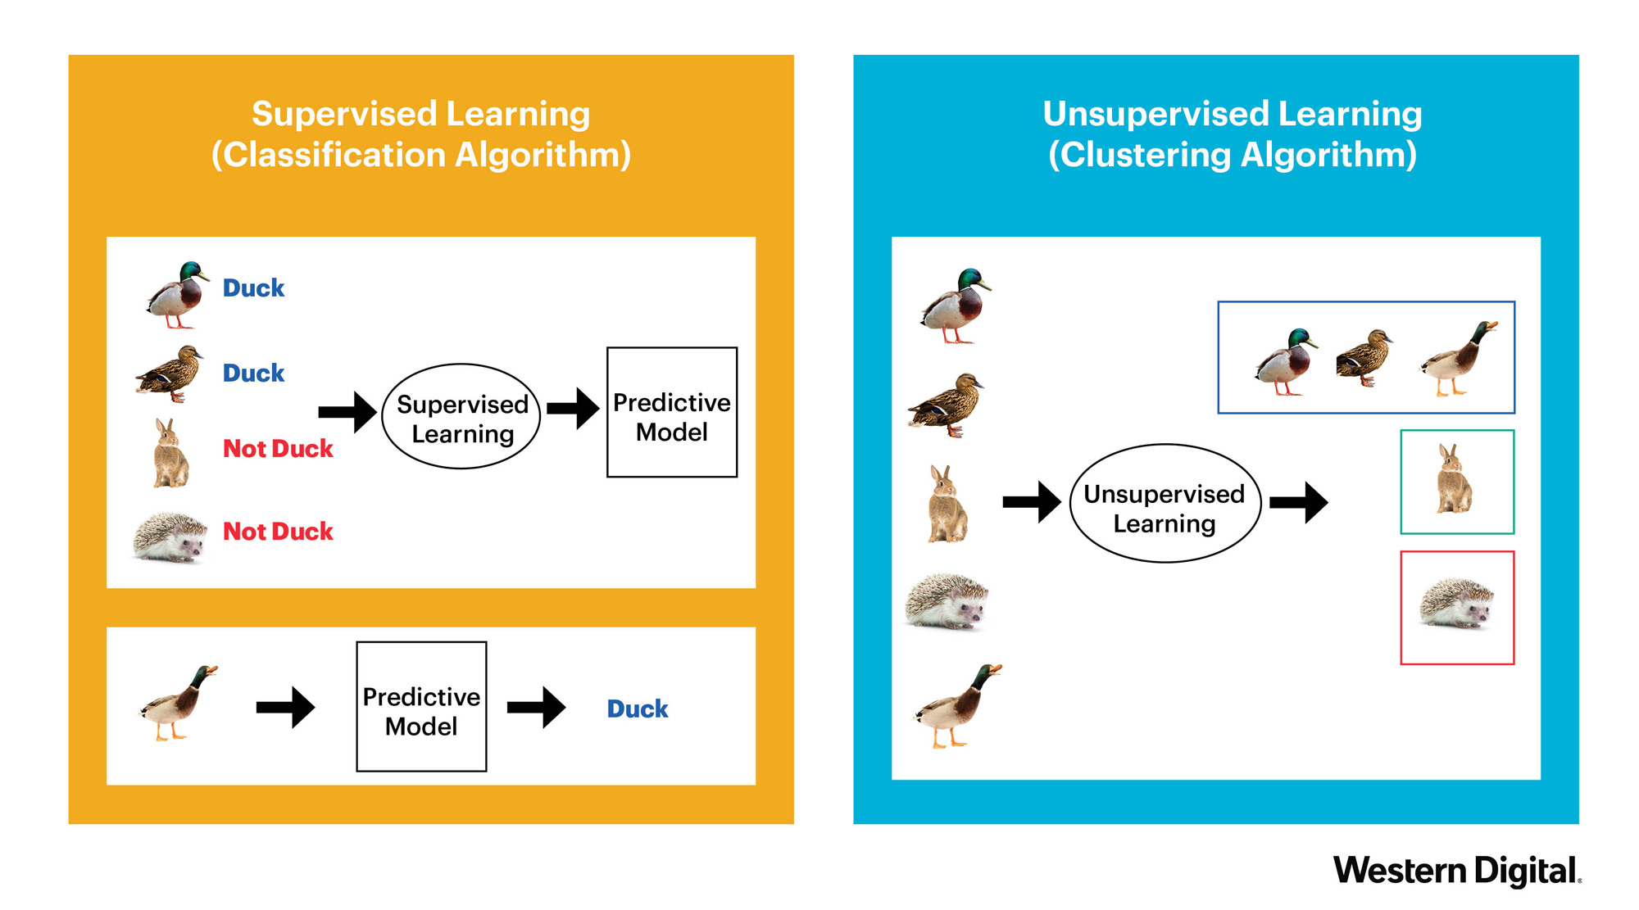
Supervised Learning
Learn a model from labeled training data that allows us to make predictions about unseen or future data.

Slide 22
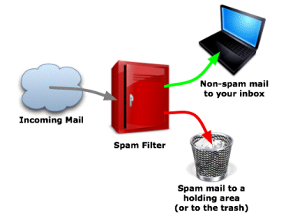
Supervised Learning
Making predictions using data
Example: Is a given email "spam" or "ham"?
There is an outcome we are trying to predict

Slide 23

Supervised Learning:
Classification vs. Regression
Notes:
Classification: goal is to predict categorical labels of new instances based on past observations
Discrete, unordered
Regression: predicting continuous outcomes
??? biological example

Slide 24
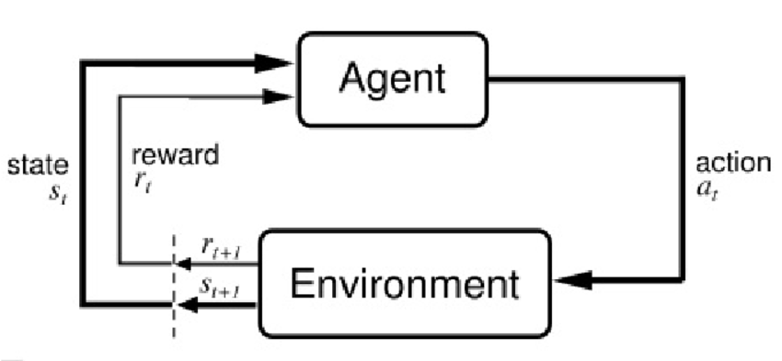
Reinforcement Learning
Notes:
Develop a system (agent) that improves its performance based on interactions with the environment
???biological example

Slide 25
Unsupervised Learning
Discover hidden structure in unlabeled data.

Slide 26
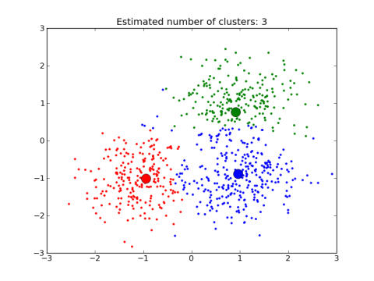
Unsupervised Learning
Extracting structure from data
Example: Segment grocery store shoppers into clusters that exhibit similar behaviors
There is no "right answer"

Slide 27

Unsupervised Learning: Clustering
Organize data into meaningful subgroups (clusters) without any prior knowledge of their group membership

Slide 28
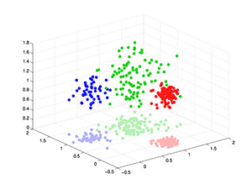
Unsupervised Learning: Dimensionality Reduction
Feature preprocessing to reduce dimensionality of data (remove noise)

Slide 30
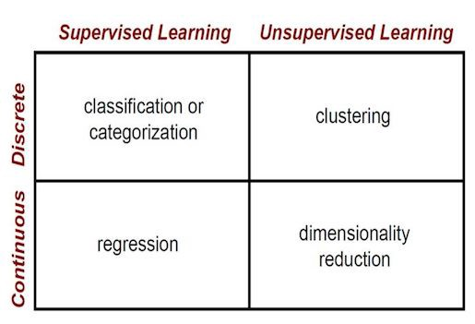

Slide 31
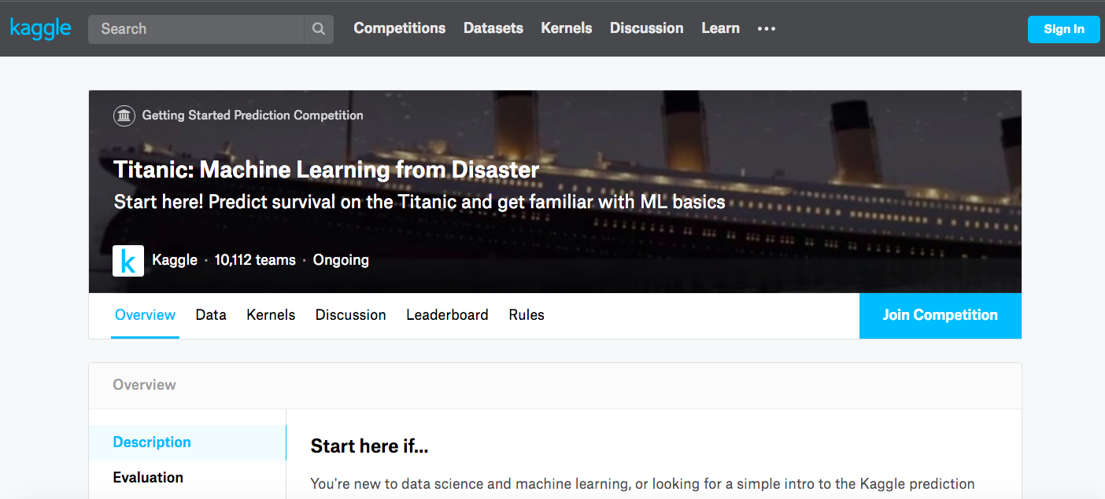
Supervised or Unsupervised Learning?

Slide 32
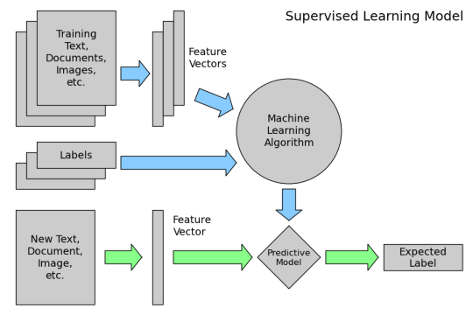
How does machine learning work?
High-level steps of supervised learning:
First, train a machine learning model using
labeled data
"Labeled data" has been labeled with
the outcome
"Machine learning model" learns the
relationship between the attributes of the
data and its outcome
2) Then, make predictions on new data for which the label is unknown
The primary goal of supervised learning is to build a model that "generalizes": It accurately predicts the future rather than the past!

Slide 33
Gradient Descent
Notes:
Do the demo!

Slide 34
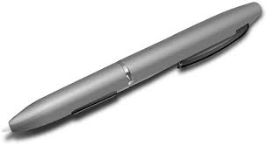
Training a robot to
go to the pen

Slide 35


Slide 36
Pen: Minimize Distance
Mountain: Minimize Height
Any Machine Learning Problem: Minimize the Error
Notes:
Any problem: minimize error--for any problem we define the problem, find the error and minimize it using gradient descent

Slide 37

Gradient Descent is minimizing the error.
Notes:
Error is how “off” we are or how wrong we are.
J(w) is our error or cost function

Slide 38
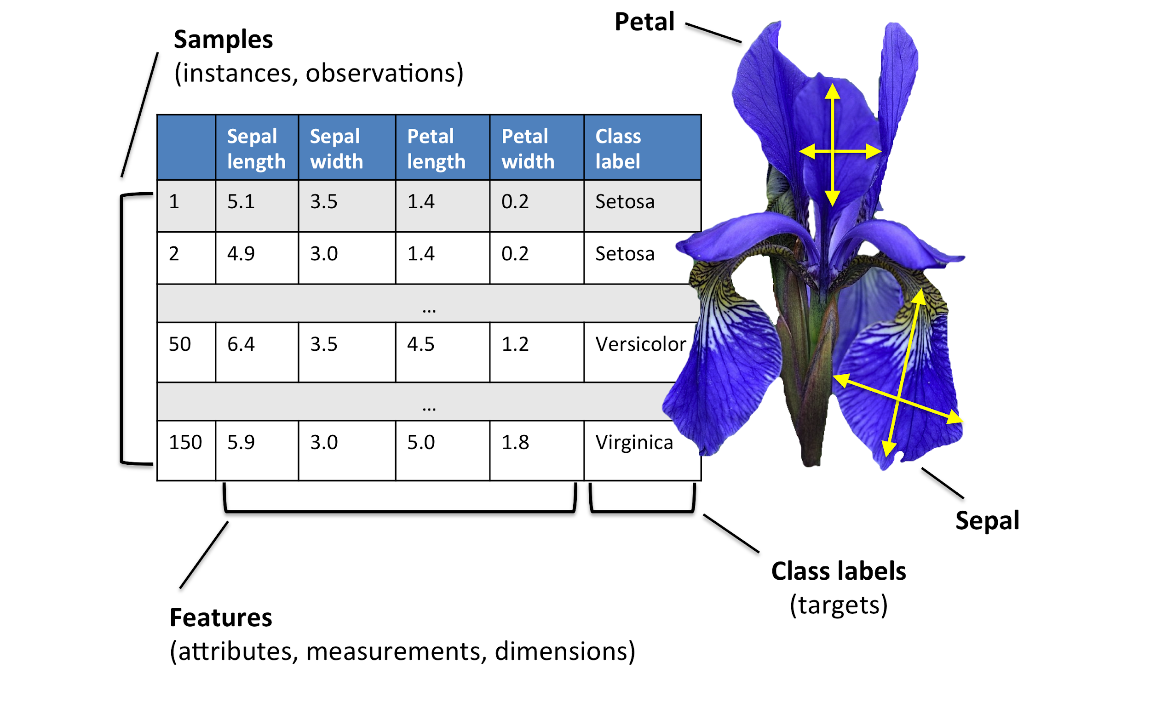
Basic Terminology

Slide 39
Let’s take a look at one of the .csv files in our folder and try to use some of our new vocabulary terms...

Slide 40
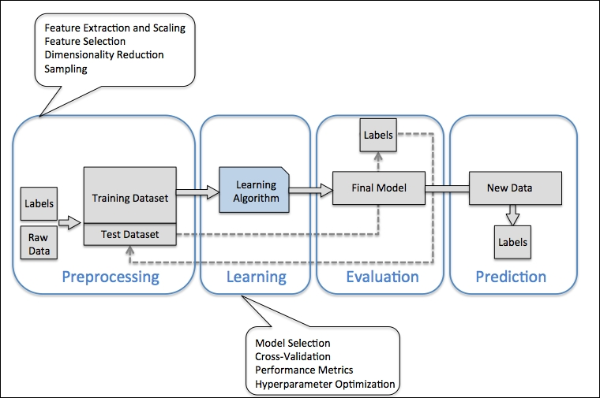

Slide 41
Preprocessing
From raw data to measurement data.
Scaling data
Dimensionality reduction
Splitting into training and testing sets

Slide 42
Training and Selecting a Model
No “silver bullet” model.
Compare performance.
Cross-validation.
Hyperparameter optimization.

Slide 43
Evaluating and Predicting
How the model performs on unseen data (how well does it generalize?)
Use model to predict new, future data

Slide 44
Get to know your coursemates!
You can work in groups or on your own.
Pick one of these questions or make up your own:
What is your current favorite tool for working with data?
What are you most excited about learning?
What can you help your classmates with when it comes to data analysis?
Collect data on your classmates.
Summarize your findings in a narrative, visualization, etc. (feel free to be creative)

